Slide 1
Preliminary Analysis of Veteran Disability
Amanda Fredrickson
DAP2 Final Project

Slide 2
Motivation
In FY22, $125B spent on disability payments to 5.3M veterans (about a third of all living veterans), more than is spent on healthcare
Average is $20k/person. We pay veterans to be unhealthy, not healthy
The money is supposed to correspond to the severity of service-connected conditions, and average earnings loss expected as a result of these conditions
Ranges from 0% to 30% for bad knees, to 100% for loss of limb(s)
Culture of “get what I am owed” – but how much, truly, are you owed?
CBO 2022 report suggesting means testing these benefits for households earning more than $170k

Slide 3
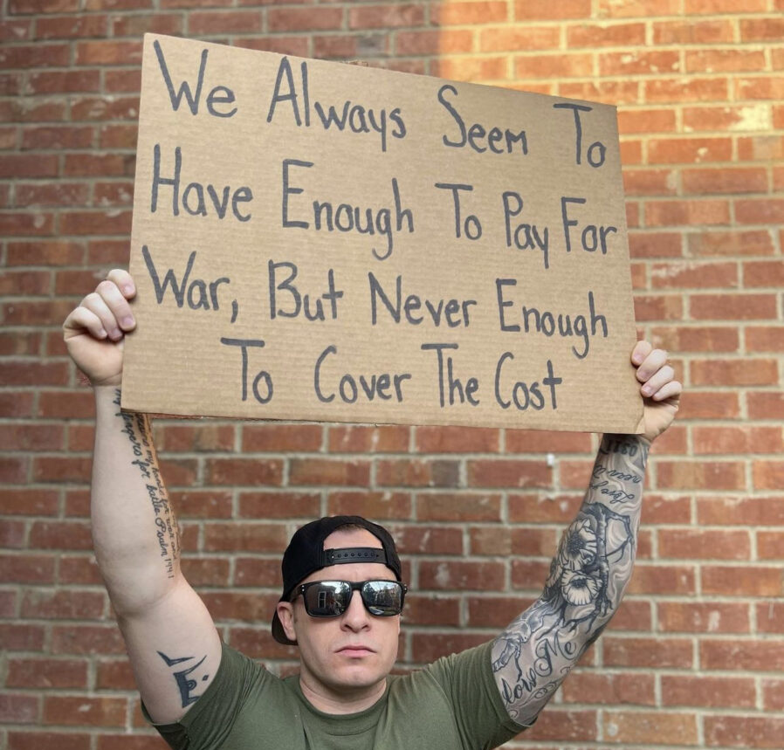
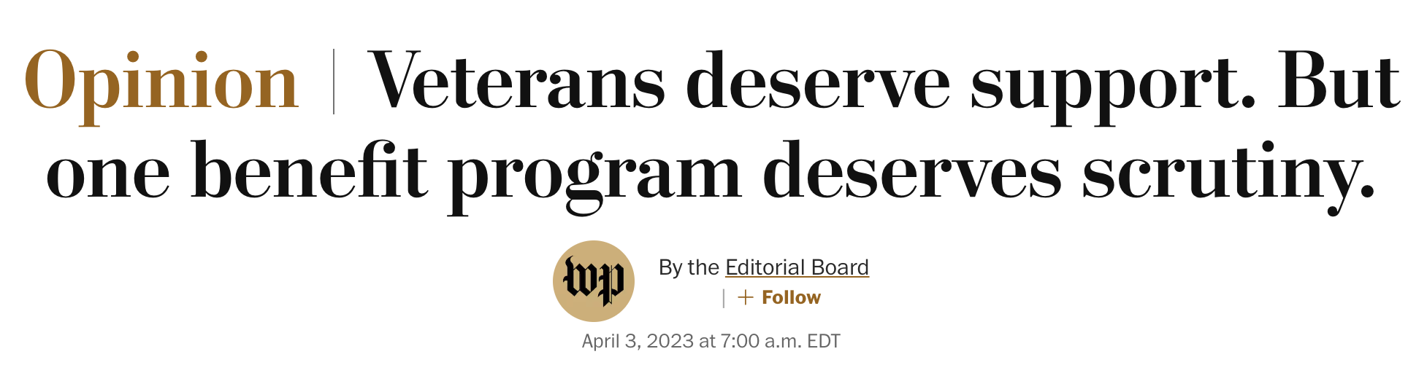
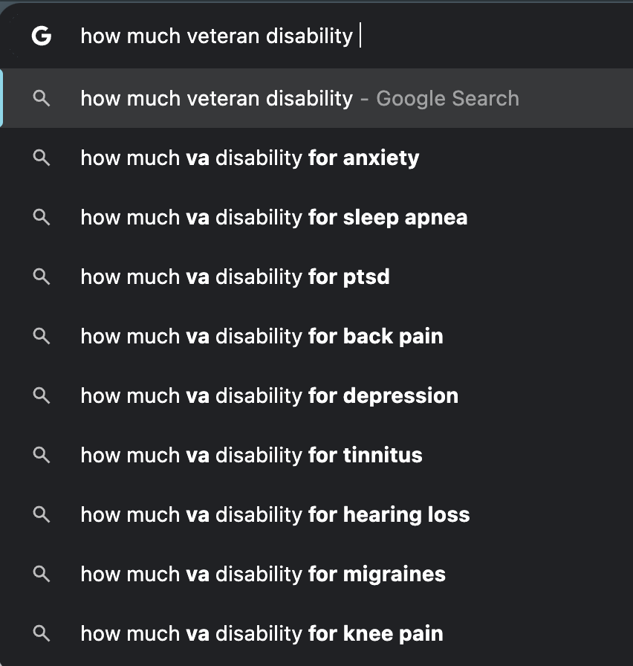




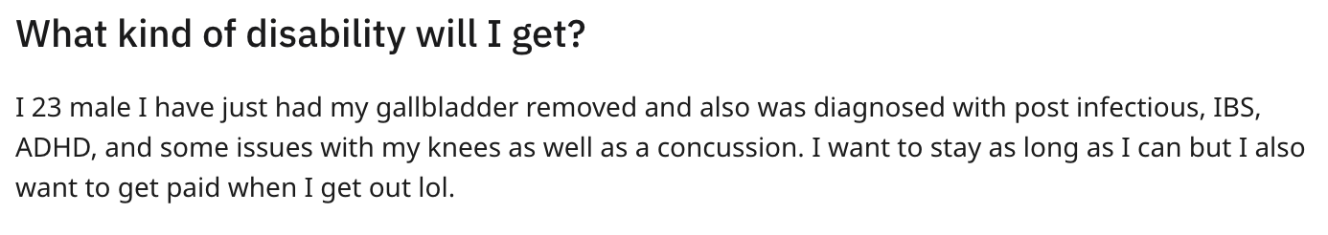

Slide 4
Research Question
Rating of 10-20% earn about the same as veterans with no rating
30-60% earn slightly less, 70+% earned much less,
Does a high rating mean they can’t work, or have enough benefits not to?
How much of this is deterministic? Slightly outside my scope ☺
But, I wanted to explore the effects of receiving disability payments on income and LFP compared to non-veteran population on my own, as well as on a by-state basis, as I find it interesting how many areas of the country contribute or don’t contribute servicemembers, and who returns to their home state post-service to contribute (or not)

Slide 5
Data Sources
1) IPUMS
2011 and 2016 ACS results
STATE, AGE, LABFORCE, INCTOT, INCWAGE, VETDISAB, VETSTAT
2) IPUMS CPS Veterans Supplement
2021 and 2022 (regular IPUMS surprisingly more comprehensive than Veterans Supplement)
STATE, HHINCOME, FAMINC, AGE, VETSTAT, LABFORCE
3) Top five Google searches for ”CBO means testing VA disability”
Law firms, veteran groups and advocates, blogs and nonprofits

Slide 6
Methods
Cleaned both IPUMS data sources
Transformed STATEFIP into named states
Produced age groups by age
Produced a disability rating grouping from VETDISAB
N/A, no rating, 1-60%, 70+%
Produced variables to make plots
lfp_by_age_vet, veterans_data, etc
Scraped article text content through CSS selectors (could expand further)
Visualized basic data trends, decided to focus on LFP by age group and veteran status, then expand to see how disability rating impacts
Then evaluated income differences by veteran status by state
Evaluated sentiment analysis around web results surrounding means testing

Slide 7
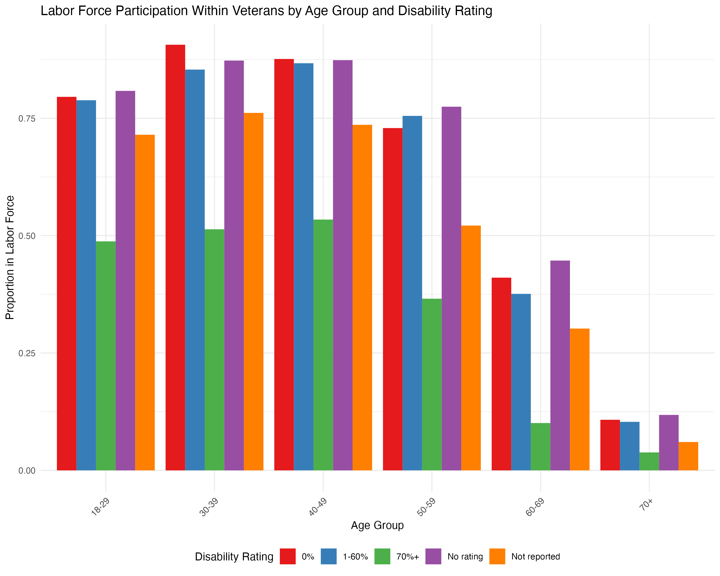
Discussion of Figures (1/2)

Slide 8
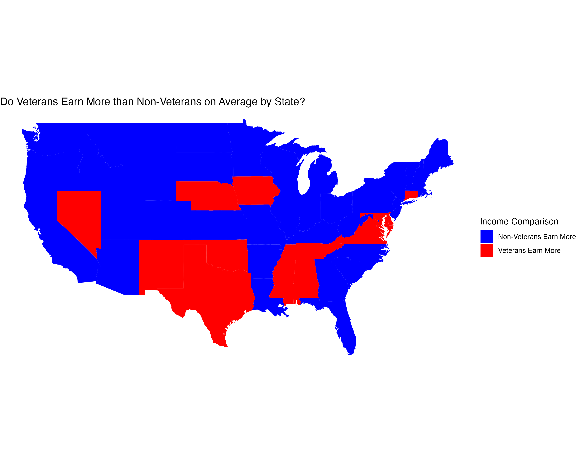
Discussion of Figures (2/2)

Slide 9
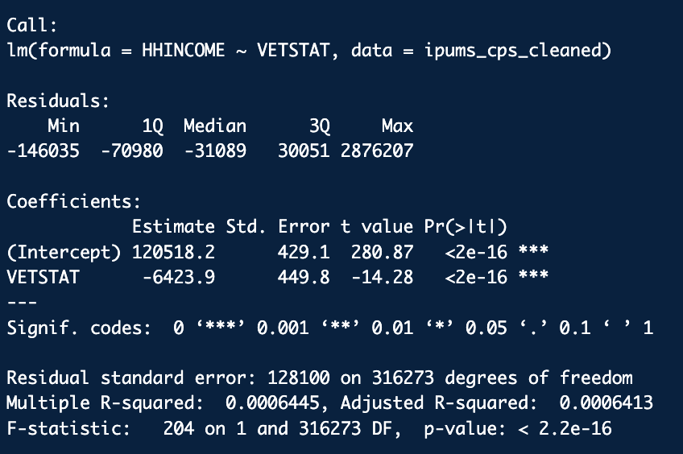
Regression Model

Slide 10
Demo Shiny App
Demo a by state comparative analysis of veteran outcomes
Earnings and labor force participation
Veterans make up 6% of overall population (2022 numbers)
Most illustrative: Alaska at 10%, Wyoming and Virginia both around 9%
California 4.3%, NJ and NY and <4%
Other Shiny app looked at by age group, veteran versus non-veteran outcomes (earnings and LFP) between disability levels

Slide 11

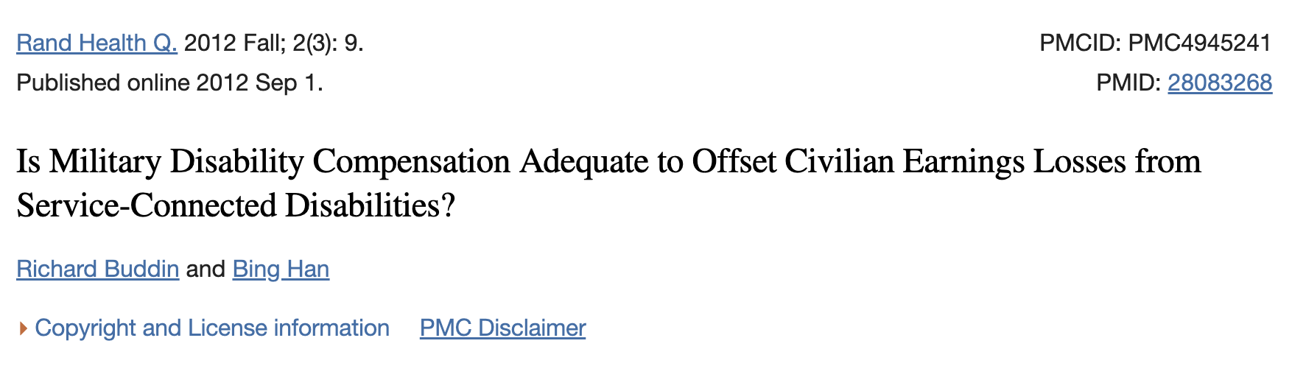
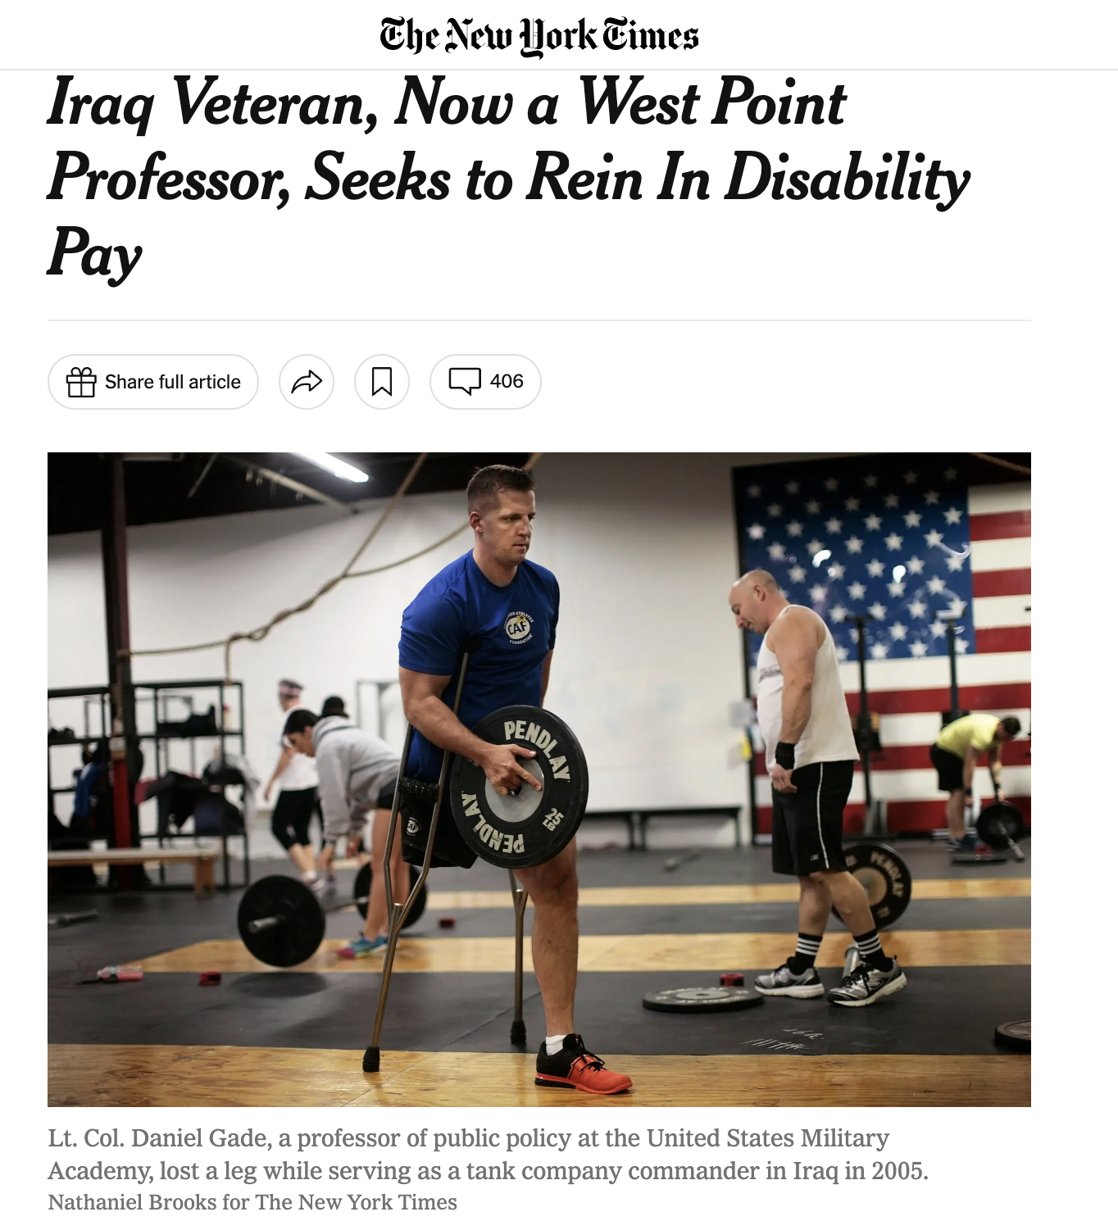
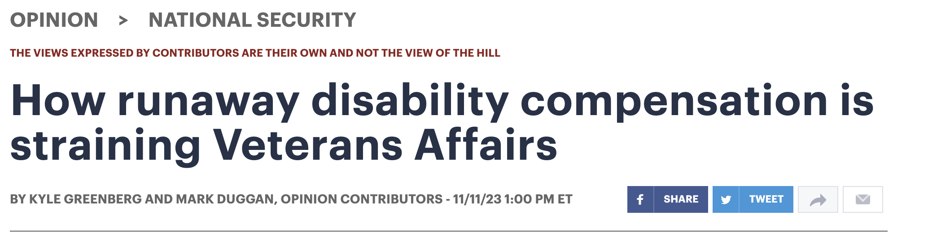
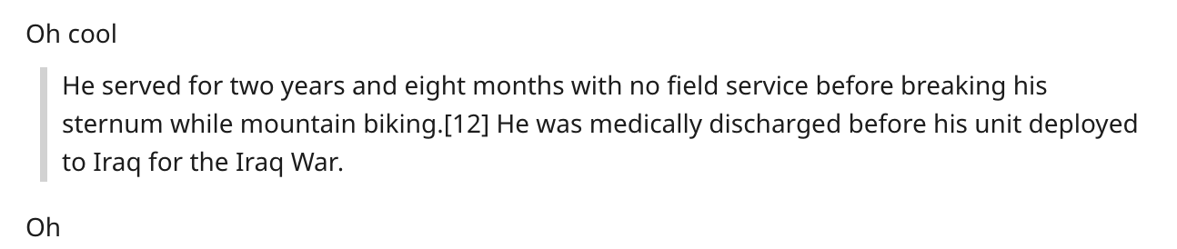
Conclusion and Directions for Future Work

Slide 12
Questions?
Thank you!

